Slide 1
Orion Health – Assignment Discussion
Presentation by Unmesh Kulkarni

Slide 2
Part 1 : Accomplishment
TECO Monitoring System
“Designed and Implemented a system which is having large data and running in Production for last 30 months with 100% availability”

Slide 3
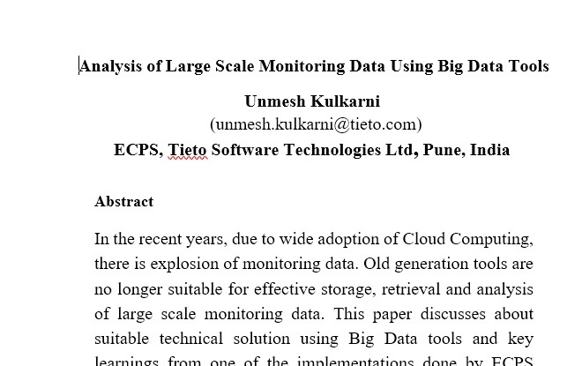

Large Scale Monitoring Data System
Why I am proud of it?
System is running in production with 100% availability for last 2.5 years
Presented white paper related to this and won prize.
Solved unique challenges by “Out of box” thinking.
The case study was used un many sales presentations.
Cost savings as the system is based on OpenSource products
My Role
Ideation | POC | Design
Implementation | Integration | L3 Support

Slide 4
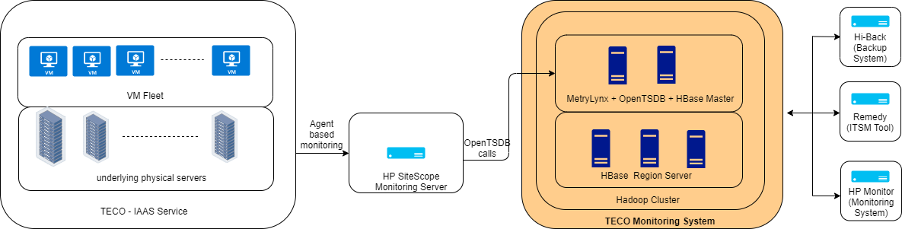
Architecture & Scale
Scale of the system (Till Q3 - 19)
Data size | 7 TB (compressed) | Speed | 600 Events/Sec

Slide 5
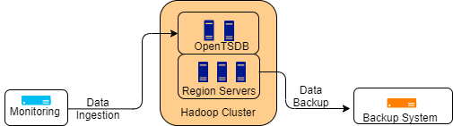
DR - Major Roadblock
Requirement :
A disaster recovery (DR)solution should be in place as data is used for SLA ( and hence) financial calculations for IAAS users.
Typical Backup System
Challenges ( Alternative ways : Spent around 1 month for finding right solution)
Hbase snapshots | It’s a shallow copy hence can not be used
Hbase Replication | Expensive as it needs another cluster
Hbase Exports | Not reliable. Also mean time to recovery is around 25 days

Slide 6
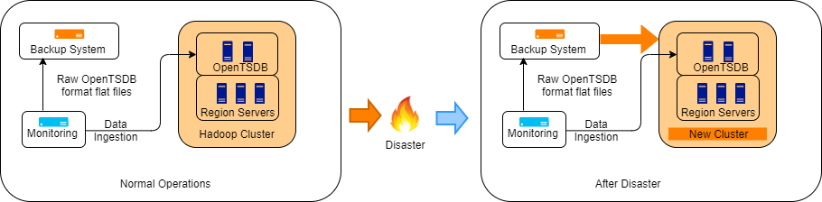
DR Solution – “Out of Box” Thinking
Advantages of the solution
Time to recovery | It came down to minutes once the new cluster is ready compared to 25 days
Cost | Very minimal cost due to storing partial raw data
Reliable | System worked well when live streaming as well as backup data was ingested simultaniously

Slide 7
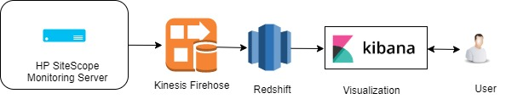
Better ways – How I will solve it now.
Advantages
Zero lead time ( It took us 2 months to get server delivery and commissioning in data center from HP)
No overhead of hardware management ( We generally have 1 disk failure per 7 months )
Pay as you go. (Could not commercialized this as a solution due to high initial price)
Easy security ( IAM is easy to understand compared to Kerberose in Hadoop)
Backup, Scaling up the cluster is simple

Slide 8
PART 2: SMTP Proxy

Slide 9
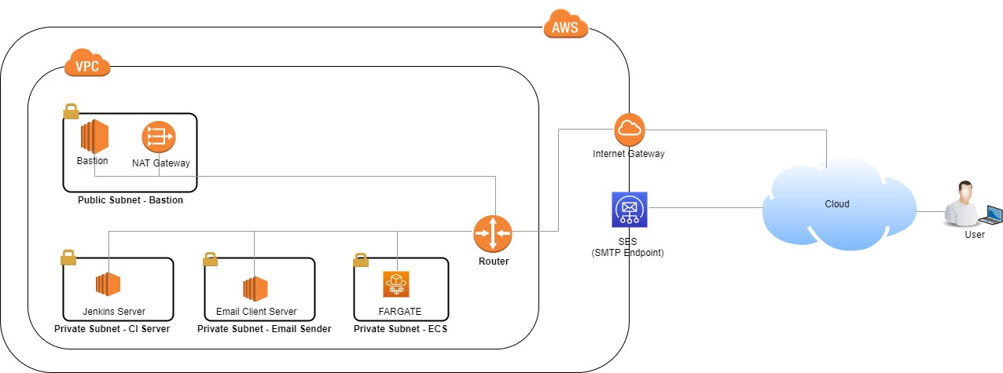
Deployment Setup

Slide 10
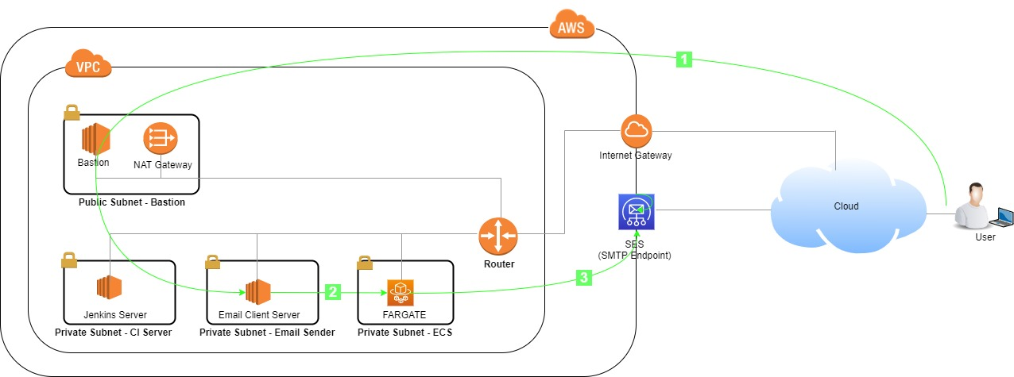
Operation Flow

Slide 11
Demo

Slide 12
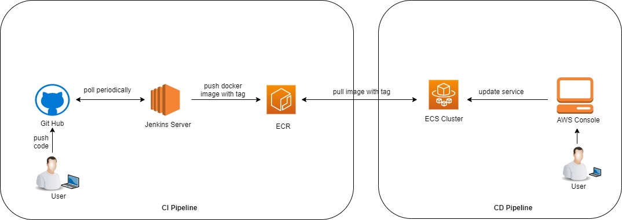
CI/CD

Slide 13
Positives and Improvements
Positives
SMTP communication happens using TLS
All other ports except 1587 are blocked in Docker
Security group allows communication only from Email Sender and only on port 1587
In case of container crash, new container will be spawned by ECS service.
Improvements
Auto scaling can be enabled on ECS EC2 instances.
More number of container instances with load balancer can be used to provide high availability for container service
Jenkins can be used to for CD instead of using AWS management console
Current setup is done manually. It can be automated using Terraform

Slide 14
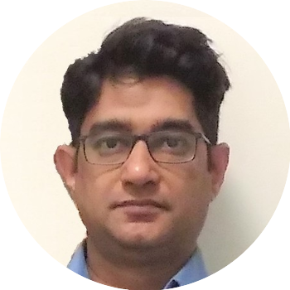
Kia Ora !
Thank You !
धन्यवाद!

